Slide 1
Human Activity Recognition
Edwin Candinegara

Slide 2
Objectives
Real-time Smartphone based Human Activity Recognition
Smartwatch based Human Activity Recognition
Notes:
= Data collection process → documentation
= Activity description
Versus available data currentls

Slide 3
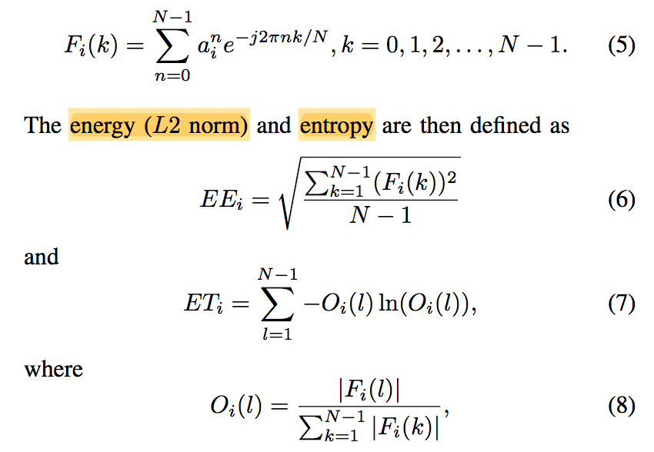

Features
Mean
$a_{x},a_{y},a_{z},a_{mag}$
Variance
$a_{x},a_{y},a_{z},a_{mag}$
Energy
$a_{x},a_{y},a_{z},a_{mag}$
Entropy
$a_{x},a_{y},a_{z},a_{mag}$
Correlation
$a_{xy},a_{xz},a_{xmag},a_{yz},a_{ymag},a_{zmag}$
Notes:
= Data collection process → documentation
= Activity description
Versus available data currentls

Slide 4
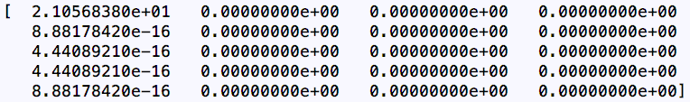
Issues
Calculation for entropy may generate errors because the value of O(l) can be 0 because the nominator is 0 → log(0) error
One example of the FFT result vector:
What value should be returned then for entropy in this case?

Slide 5

Issues
Calculation for entropy may generate errors because the value of the denominator in O(l) can be 0 → division by zero error
One example of the FFT result vector:
What value should be returned then for entropy in this case?

Slide 6
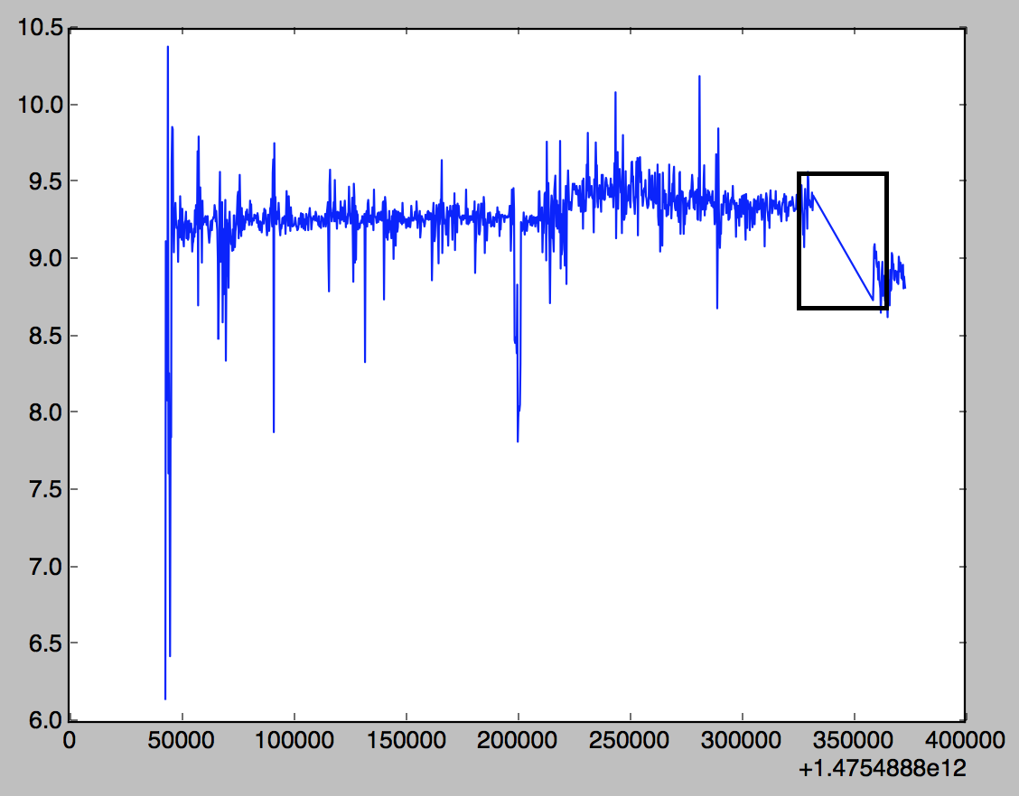
Issues with Smartwatch
Timestamp can jump to a number bigger than the previous sensor reading
Unpredictable
Need to record again for 6-7 activities
Probably by splitting it into 2-3 stages instead of one go

Slide 7
What’s next?
Retake data for some activities
Fixing features extraction (the entropy issue)
Build first model
SVM
HMM
NB
Random Forest

